Slide 1
Latent variable models
Session 1 – Introduction

Slide 2
Dr. Zsuzsa Bakk & Dr Mathilde Verdam
Methodology and Statistics Unit
Leiden University
z.bakk@fsw.leidenuniv.nl
A course overview has been provided under ‘Contents` > ‘Course Overview’ on Brightspace page.

Slide 3
Class outline
General administrative stuff
Introduction to SEM
Latent variable models introduced next week
Selected topics (also from chapter 2 of Beaujean)
From familiar regression models to SEM
Path models
Covariance matrices
Exercises

Slide 4
Course schedule
Week | Topics, chapters & deadlines
46 | Introduction: SEM or path models with observed variables only (Ch. 2)(ZB)
47 | Basic latent variable models: Confirmatory factor analysis (Ch. 3)(MV) Available on Brightspace: Assignment 1
48 | Multiple group analyses: Equality restrictions on model parameters between groups (Ch. 4) (MV)
49 | Latent class analysis (separate articles on Brightspace)(ZB) Due date: Turn in Assignment 1 (10-12-2022) Available on Brightspace: Assignment 2
50 | No class Grades and feedback: Assignment 1

Slide 5
Course schedule
Week | Topics, chapters & deadlines
51 | Item response theory models: Similarities and differences between IRT and SEM/CFA (Ch. 6)(ZB) Due date: Turn in Assignment 2 (05-01-2023) Available on Brightspace: Assignment 3
52-1 | No class: Christmas & New Years
2 | Hierarchical latent variable models: Multiple layers of latent variables (Ch. 9)(MV) Grades and feedback: Assignment 2
3 | Missing data, sample size, miscellaneous topics (Ch. 7, Ch. 8)(ZB)
31-01-23 Due date: Assignment 3

Slide 6
Final course grade
Final grade determined by the weighted average:
First and second assignment: structured (each 25%)
Fitting SEMs / LVMs to data
Interpreting results
Theoretical / insight questions
Third assignment: much less structured (50%)
Choose SEM or LVM analysis to perform on dataset of own choosing
analysis should be advanced (e.g., multigroup analysis, LC/IRT model with covariates, hierarchical CFA, CFA and LCA combined, etc.)
Report should be written according to APA standards (introduction, method, results, discussion), with report focusing on
Selecting an appropriate method for answering a substantial research question
Performing and describing the LVM analysis
Providing a correct and substantial interpretation of the results

Slide 7
Course prerequisites
Knowledge of statistics
Statistical testing (e.g., chi-square & normal distributions)
Regression (GLMs)
Var, cov, cor, mean
Knowledge of psychometrics
Validity
PCA, EFA, CFA
Reliability
IRT
Matrix algebra
Addition, multiplication, diagonal, inverse
Programming in R

Slide 8
Course materials
Book(s):
Beaujean, A. A. (2014). Latent variable modeling using R: A step-by-step guide.
Good as a starting guide, not an authorative standard
Kaplan, D. (2009). Structural Equation Modeling: Foundations and Extensions.
Authorative standard. But more technical and not focused on specific software, so less practical.
Brightspace materials:
Lecture slides
Markdown files for examples and exercises

Slide 9
Book examples
You are strongly advised to copy and run R code from examples in Beaujean book and from Brightspace:
They give you a step-by-step guide on how to perform analyses
They give you a starter for making the exercises
If you make a mistake, you will get an error or warning message, from which you learn A LOT! (But only you read and try to decipher! Just remember: red = good!)

Slide 10
LVM class structure
Preparation: Read chapter(s) of the Beaujean book & watch recorded lecture
Lab session:
Q&A on lecture
On current weeks topic
Questions (on current and past topics)
Work individually on exercises
Homework:
Complete exercises at home
Check with worked out answers on Brightspace

Slide 11
Structural Equation Modeling
SEM: the modeling of structural equations
Modeling: we are constructing models (hypotheses, theories) of reality. The models (theory, hypothesis) can be statistically tested. That is: rejected by the data (or not), but never proven ‘true’ or ‘right’.
In fact, all models are wrong, but some are useful approximations to reality. So a statistic (e.g., p-value) itself does not decide whether a model is right or wrong. We have to decide whether a fitted model or parameter estimate provides useful information
Structural: the model is used to explain the interrelations between (that is, the structure of) observed variables
Equations: the interrelations between variables in the model are described using mathematical formulae (equations)

Slide 12
Structural Equation Modeling
SEMS are graphically represented using the following building blocks:
Observed (manifest) variable
Directional relationship (regression relationship)
Non-directional relationship
(correlation/(co)variance)
Latent variable
Constant term (i.e., not a variable, e.g., intercept)

Slide 13
Structural Equation Modeling
The arrows in SEM denote regression relationships, of the linear type
Therefore, all generalized linear models (GLMs) can also be formulated as SEM models, e.g.,
t-test
ANOVA
Multiple linear regression
Multiple logistic regression
…..
Also, SEM can be used to models for multilevel or longitudinal data (i.e., GLMMs, or generalized linear mixed-effects models)

Slide 14
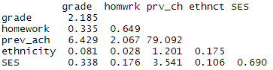
Example dataset
Variables in the model:
GPA in 10th grade
Ethnicity
Homework (8th grade)
Socio-economic status
Previous achievement (8th grade)
Sample covariance matrix S:
grade
ethnicity
homework
SES
Prev_ach

Slide 15
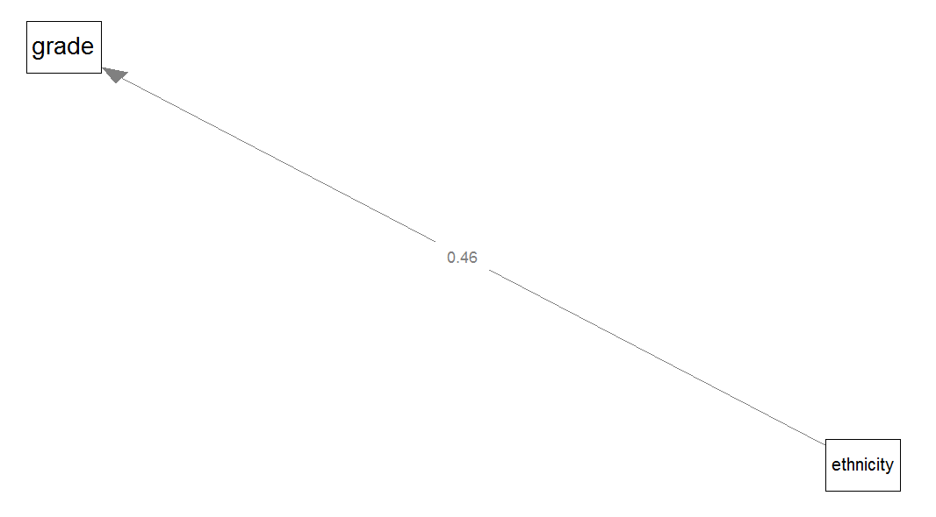

Model: Univariate regression
Dependent:
GPA in 10th grade
Independent:
ethnicity (0=ethnic minority; 1=ethnic majority)
Regression coefficient easy to calculate by hand:
${\hat{b}}_{xy}=$ $\frac{{cov}_{x,y}}{{var}_{x}}=\frac{0.0814}{0.1752}\text{=0.4646}$
standardized ${\hat{b}}_{xy}=$ ${\hat{ρ}}_{xy}=$ $\frac{{cov}_{x,y}}{s_{x}s_{y}}=s_{x}\frac{{\hat{b}}_{xy}}{s_{y}}=0.132$
Measure of fit or (strength of) association: ${{\hat{ρ}}_{xy}}_{}^{2}$

Slide 16
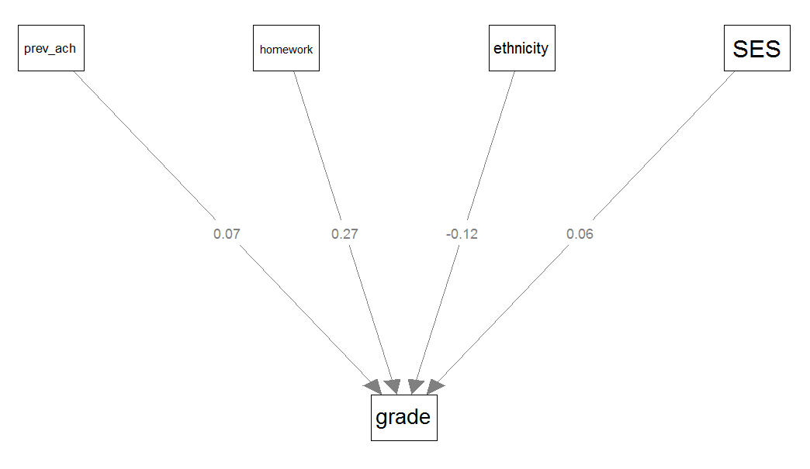

Model: Multiple regression
Dependent:
GPA in 10th grade
Independent:
Ethnicity
Homework (8th grade)
Previous achievement (8th grade)
Socio-economic status
Regression estimates are now a vector of partial regression coefficients, need matrix algebra to compute: $\hat{β}={{(X}^{T}X)}^{−1}X^{T}y$
Measure of fit: multiple correlation (R=.512), or variance explained (R²=.262)
Measure of (strength of) association: ${\hat{b}}_{xy}$ or standardized ${\hat{b}}_{xy}=s_{x}\frac{{\hat{b}}_{xy}}{s_{y}}$ (where ${\hat{b}}_{xy}$ is now a partial regression coefficient)

Slide 17
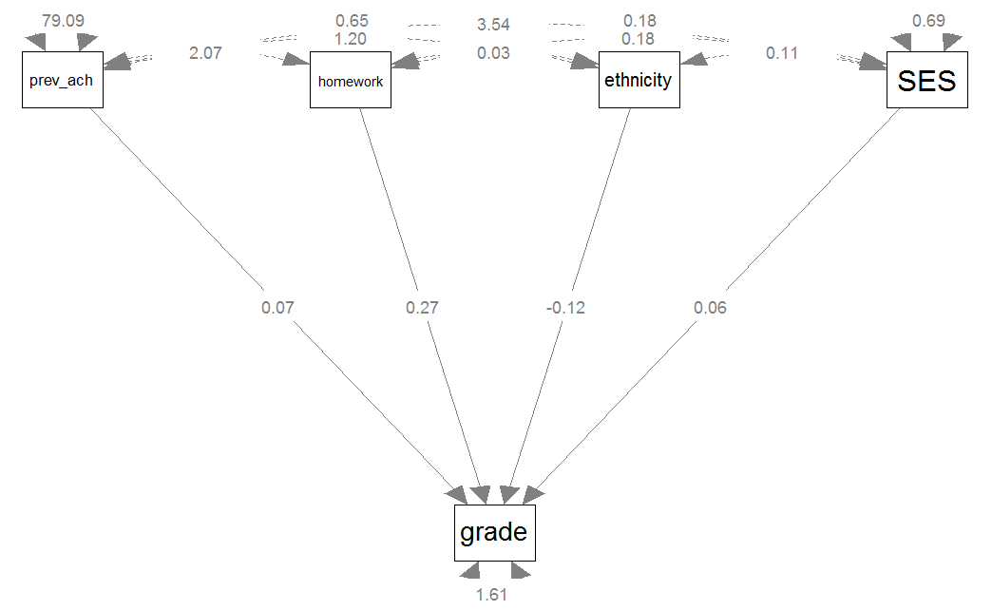

Model: SEM
Endogenous variables:
GPA in 10th grade
Exogenous variables:
Ethnicity
Homework (8th grade)
Previous achievement (8th grade)
Socio-economic status
(disturbance/error/residual) of GPA in 10th grade
Regression estimates are still a vector of partial regression coefficients, need matrix algebra and optimization to compute
Measure of (strength of) associations: Partial regression coefficients
Overall model fit: How well are the observed variables’ (co)variances reproduced by the model?
Quantified by a $χ^{2}$value and model fit indices

Slide 18
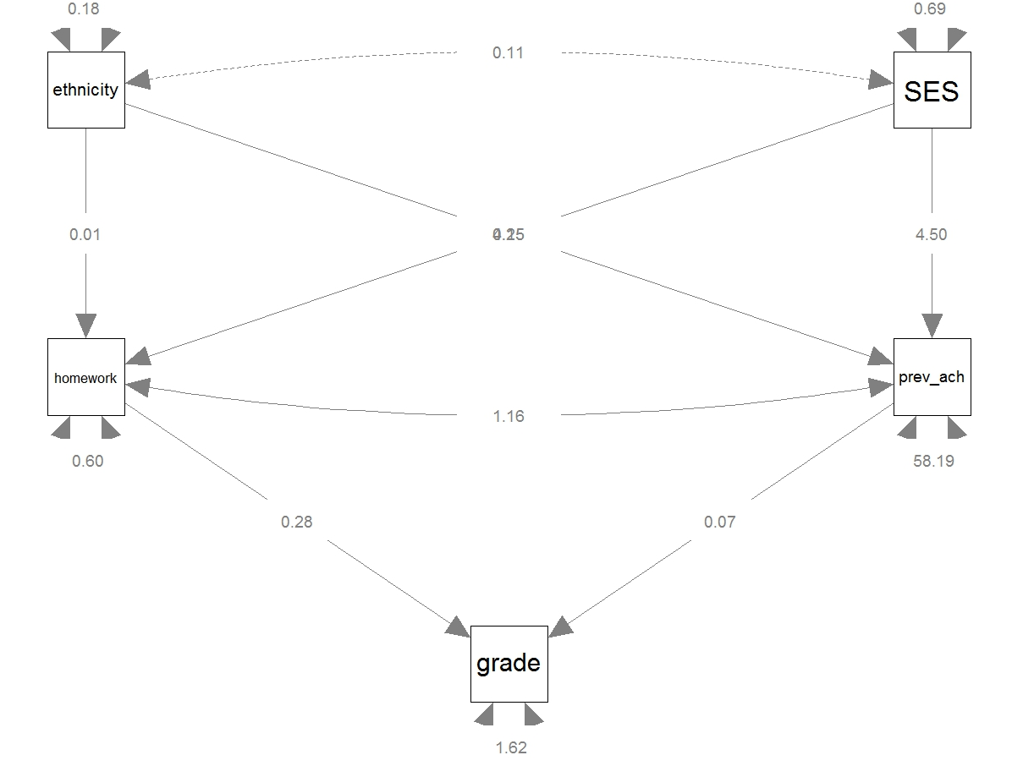

Model: SEM
Endogenous variables:
Homework (8th grade)
Previous achievement (8th grade)
GPA in 10th grade
Exogenous variables:
Ethnicity
Socio-economic status
(disturbances/errors/residuals of
Homework (8th grade)
Previous achievement (8th grade)
GPA in 10th grade
Measure of (strength of) associations: partial regression coefficients
Overall model fit: How well are the observed variables’ (co)variances reproduced by the model?
Quantified by a $χ^{2}$value and model fit indices

Slide 19

Model: SEM
From Greek endo, meaning ‘inside’, and gignomai
Explained by the model.
Have unidirectional incoming arrows.
Endogenous variables:
Homework (8th grade)
Previous achievement (8th grade)
GPA in 10th grade
Exogenous variables:
Ethnicity
Socio-economic status
(disturbances/errors/residuals of
Homework (8th grade)
Previous achievement (8th grade)
GPA in 10th grade
Measure of (strength of) associations: partial regression coefficients
Overall model fit: How well are the observed variables’ (co)variances reproduced by the model?
Quantified by a $χ^{2}$value and model fit indices
Not explained by the model.
Have no unidirectional incoming arrow(s).
From Greek exo, meaning ‘outside’, and gignomai, meaning ‘to produce’

Slide 20
SEM using lavaan
To fit a SEM in R with lavaan, we need two things:
A dataset, which can be:
Raw data, which is often an external file (e.g., .sav, .xls) which needs to be loaded into R (most often the case in practice)
Covariance or correlation matrix, which can be an external file, or can be entered manually (most often the case in the book’s examples and exercises)
A model specification:
A long character string that specifies whether population parameters (associations) are restricted (e.g., to a constant like 1 or 0, or to equality) or should be freely estimated, using lavaan model syntax

Slide 21
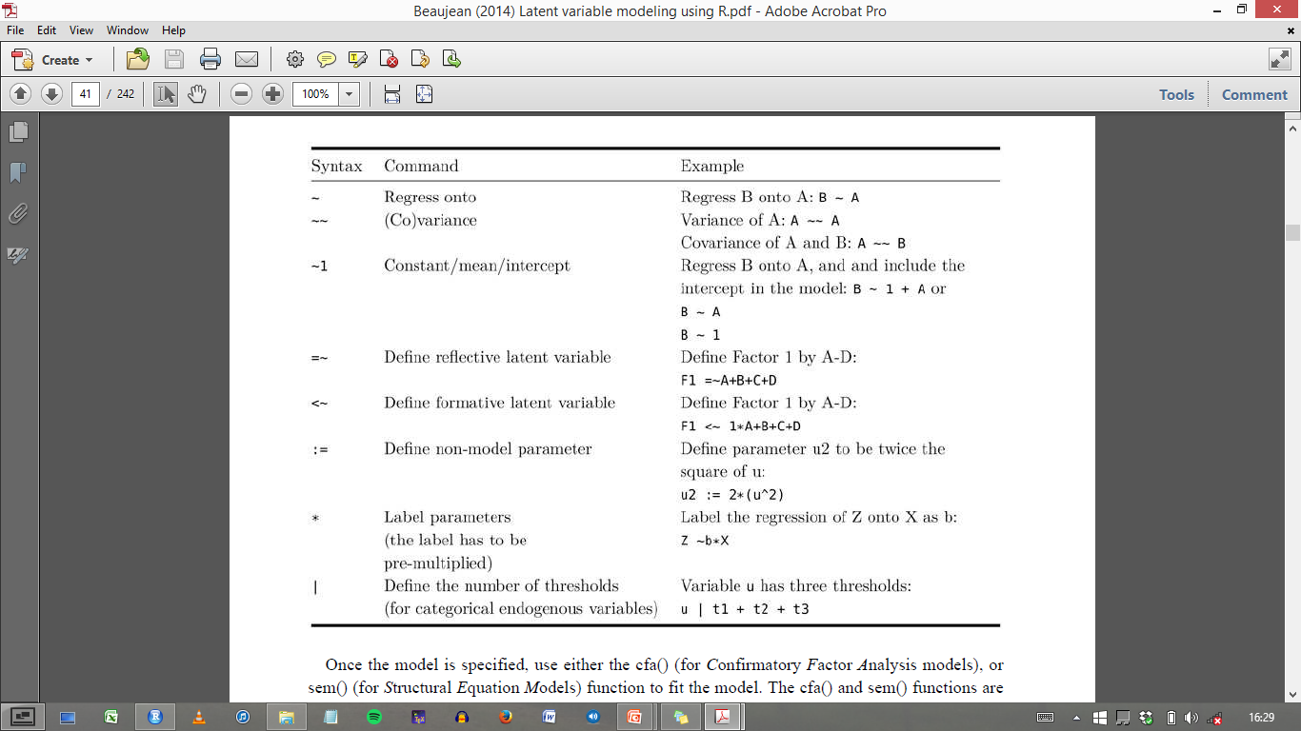
Lavaan model syntax

Slide 22
grade
ethnicity
homework
SES
Prev_ach
Q: How do we specify these models in lavaan syntax?

Slide 23

Computation time!
Example 2.4.1
get PDF from Brightspace
Make Exercise 2.1:
Get Exercises_week_1.pdf from Brightspace
These are adjusted version of the exercises in the Beaujean book

Slide 24
Structural Equation Modeling
Fitted model is used to explain the structure of, or the interrelations between observed variables
That is, to explain covariances between observed variables:
Note: means, and skewness & kurtosis can be also be involved in SEM (discussed later in course)

Slide 25
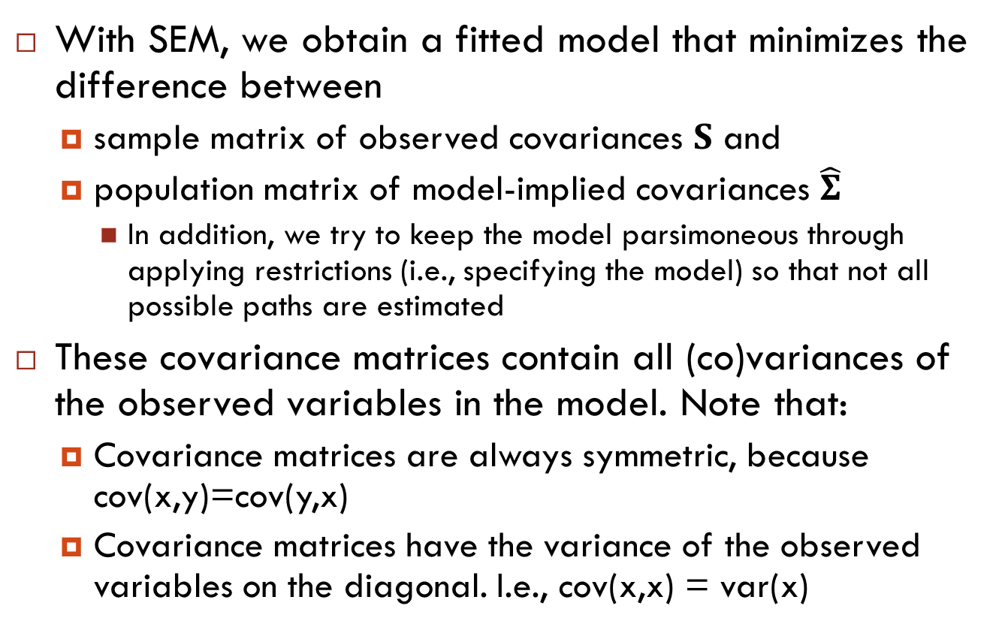
Structural Equation Modeling
With SEM, we obtain a fitted model that minimizes the difference between
sample matrix of observed covariances $S$ and
population matrix of model-implied covariances $\hat{Σ}$
In addition, we try to keep the model parsimoneous through applying restrictions (i.e., specifying the model) so that not all possible paths are estimated
These covariance matrices contain all (co)variances of the observed variables in the model. Note that:
Covariance matrices are always symmetric, because cov(x,y)=cov(y,x)
Covariance matrices have the variance of the observed variables on the diagonal. I.e., cov(x,x) = var(x)

Slide 26
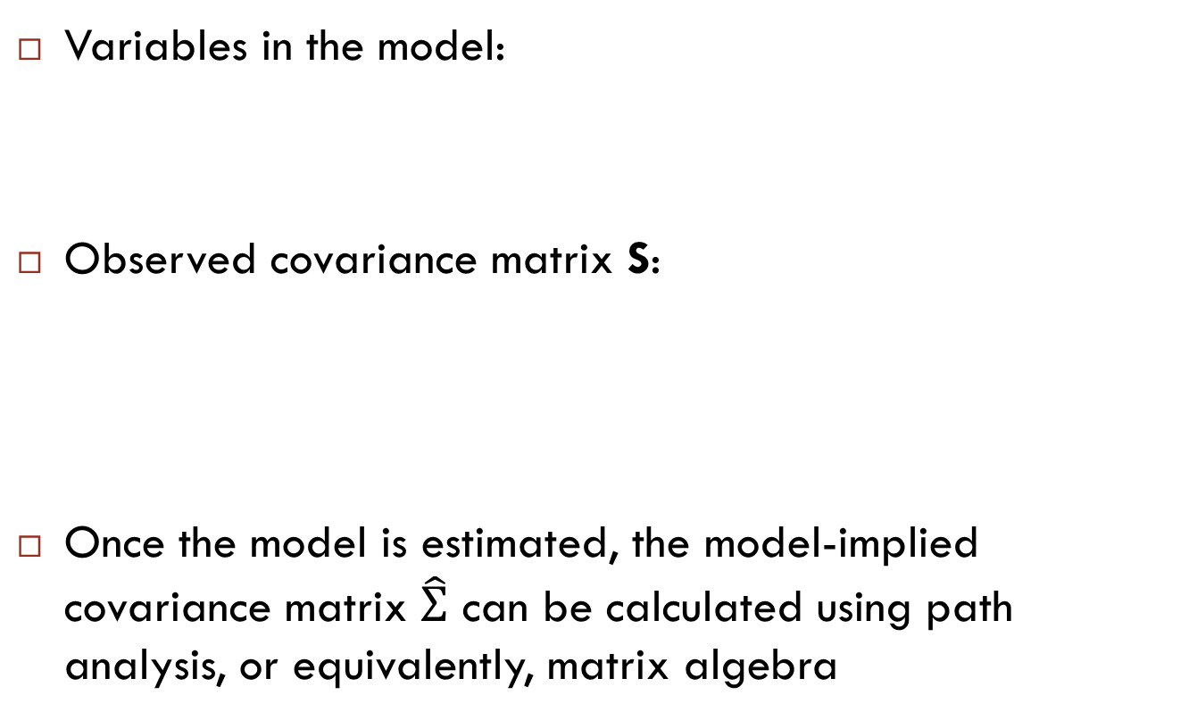
Model-implied (co)variances
Variables in the model:
Observed covariance matrix S:
Once the model is estimated, the model-implied covariance matrix $\hat{Σ}$ can be calculated using path analysis, or equivalently, matrix algebra
grade
ethnicity
homework
SES
Prev_ach

Slide 27
Model-implied (co)variances
Path analysis:
Model-implied covariance between variables X and Y can be computed as follows:
Find all paths leading from X to Y
Multiply all parameter values along a given path from X to Y, but:
No loops: may not go through same variable more than once
May switch forward/backward direction only once within a path
May go through double-headed arrow only once within a path
Summing all values thus obtained
Variances of variables are calculated as follows:
For exogenous variables, model-implied variances are equal to sample variances, so are given (not computed)
For endogenous variables, variances are computed like covariances (rules above)

Slide 28
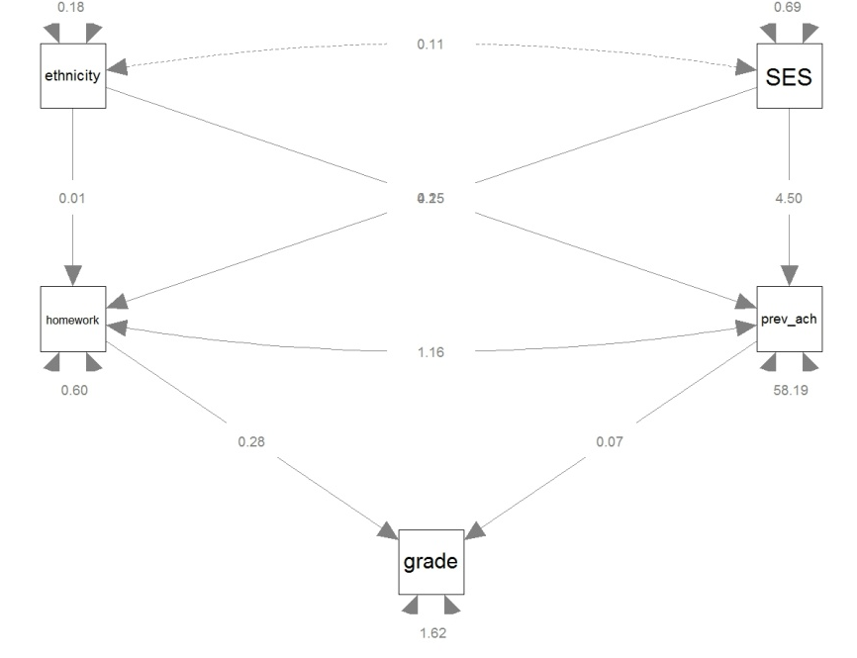
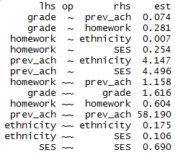
Model-implied (co)variances
Model: Parameter estimates:
model-implied cov(SES, grade)?

Slide 29
Model-implied (co)variances
model-implied cov(SES, grade)=
var(SES) * b(SES, homework) * b(homework, grade) +
var(SES) * b(SES, prev_ach) * b(prev_ach, grade) +
cov(SES, ethnicity) * b(ethnicity, homework) * b(homework, grade) +
cov(SES, ethnicity) * b(ethnicity, prev_ach) * b(prev_ach, grade)

Slide 30
Model-implied (co)variances
Note that Beaujean’s examples in section 2.1.3 seem more simple, because he uses the standardized soluttion. Then all variances of exogenous variables equal 1 and can be omitted, which simplifies calculations.
model-implied cov(SES,grade)=
var(SES) * b(SES, homework) * b(homework, grade) +
var(SES) * b(SES, prev_ach) * b(prev_ach, grade) +
cov(SES, ethnicity) * b(ethnicity, homework) * b(homework, grade) +
cov(SES, ethnicity) * b(ethnicity, prev_ach) * b(prev_ach, grade) =
.690 * .254 * .281 +
.690 * 4.496 * .074 +
.106 * .007 * .281 +
.106 * 4.147 * .074 =
0.3115514

Slide 31
Model-implied (co)variances
A SEM is a system of linear equations, which we can represent by matrices
Although non-linear SEM also exists, but is outside the scope of this course
The tracing rules represent matrix algebra but more tedious/confusing/error prone
Beaujean’s book hardly involves formulas, and no matrix notation. To get a good understanding of SEM, you need to know about underlying matrices and vectors

Slide 32
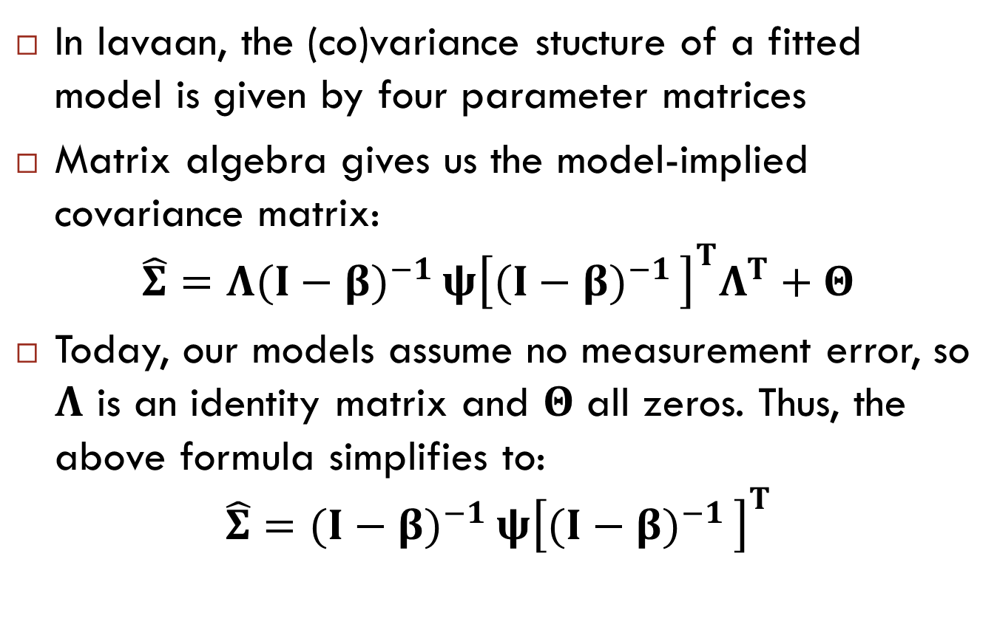
Model-implied (co)variances
In lavaan, the (co)variance stucture of a fitted model is given by four parameter matrices
Matrix algebra gives us the model-implied covariance matrix:
$$\hat{Σ}=Λ{(I−β)}^{−1 }ψ{\left[{(I−β)}^{−1 }\right]}^{T}Λ^{T}+Θ$$
Today, our models assume no measurement error, so $Λ$ is an identity matrix and $Θ$ all zeros. Thus, the above formula simplifies to:
$$\hat{Σ}={(I−β)}^{−1 }ψ{\left[{(I−β)}^{−1 }\right]}^{T}$$

Slide 33
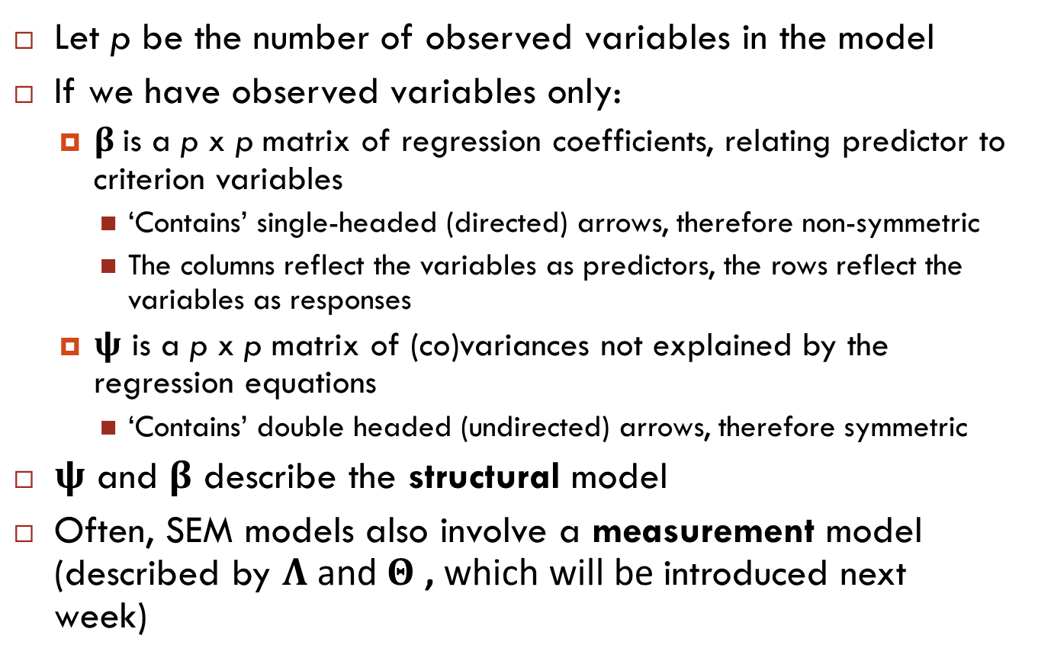
Model-implied (co)variances
Let p be the number of observed variables in the model
If we have observed variables only:
$β$is a p x p matrix of regression coefficients, relating predictor to criterion variables
‘Contains’ single-headed (directed) arrows, therefore non-symmetric
The columns reflect the variables as predictors, the rows reflect the variables as responses
$ψ$ is a p x p matrix of (co)variances not explained by the regression equations
‘Contains’ double headed (undirected) arrows, therefore symmetric
$ψ$ and $β$ describe the structural model
Often, SEM models also involve a measurement model (described by $Λ$ and $Θ$ , which will be introduced next week)

Slide 34
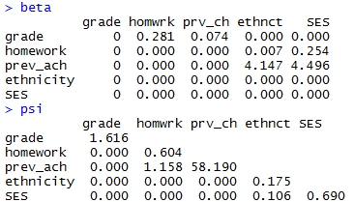
Model-implied (co)variances
Notes:
Psi: symmetric
Beta: non-symmetric. If A ~ B, then A is on row, B is on column

Slide 35
Structural and measurement model
Two main components of SEMs are distinguished:
the structural model contains causal regression relationships between endogenous and exogenous variables
path models (without measurement errors) can be viewed as SEMs that contain only the structural model
the measurement model contains the associations between latent variables and their indicators
confirmatory factor analysis models contain only the measurement part
starts next week, not this week

Slide 36
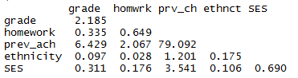

Model-implied (co)variances
Model: Parameter estimates:
Model-implied covariance matrix $\hat{Σ}$ :

Slide 37
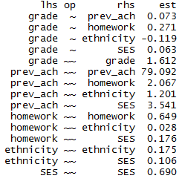
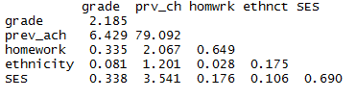

Model-implied (co)variances
Model: Parameter estimates:
Model-implied covariance matrix $\hat{Σ}$:

Slide 38
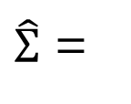
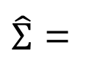
Model-implied (co)variances
$\hat{Σ}$ =
$\hat{Σ}$ =
Which model fits data best (i.e., approximates sample covariances best)?
Which is most parsimonious (i.e., estimates lowest number of population parameters)?
S =

Slide 39
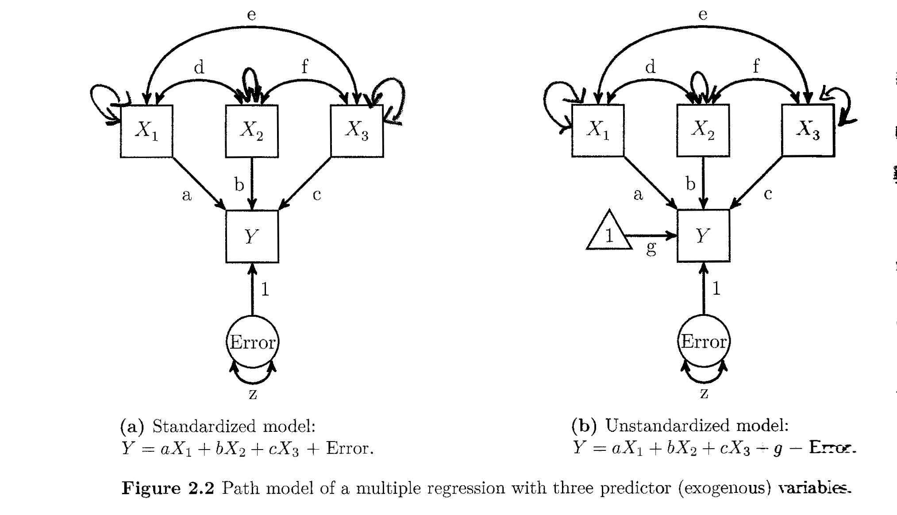
Variances of exogenous variables often not explicitly depicted

Slide 40
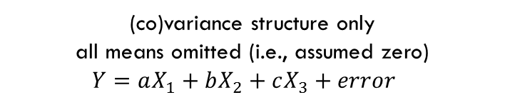
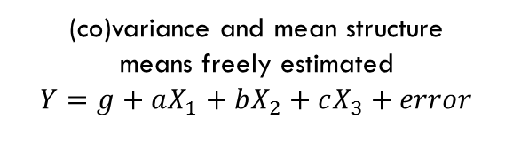
Mean structure often omitted
(co)variance structure only
all means omitted (i.e., assumed zero)
$Y=aX_{1}+bX_{2}+cX_{3}+error$
(co)variance and mean structure
means freely estimated
$Y=g+aX_{1}+bX_{2}+cX_{3}+error$

Slide 41
Error terms
Errors are latent variables: they are hypothetical, not directly observed
Error is defined as the difference between observed (sample) variance and variance explained by other variables in the model
Therefore, a variable that has an error/disturbance term is an endogenous variable
Errors/disturbance terms are always exogenous (have no incoming directional arrows)

Slide 42

Causation
Causation is a function of the research design, and cannot be determined statistically
Both models above will fit the observed data equally well, it is up to the researcher to decide on the direction of the arrows
In the SEM model, it is merely a matter of scaling:
$b_{x}=\frac{cov_{xy}}{var_{x}}$ and $b_{y}=\frac{cov_{xy}}{var_{y}}$
error
X
Y
error
Y
X

Slide 43
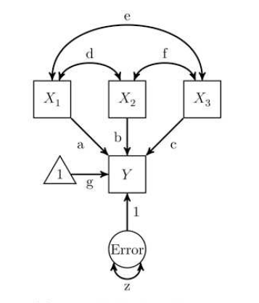
Path & partial regression coefficients
Path coefficients (a, b, c, g and 1) are partial regression coefficients
That is, the expected increase in the response variable, when the predictor variable increases by 1, controlling for (= keeping constant) all the other predictor variables
Note that the intercept is always 1, so cannot in- or decrease

Slide 44
Standardized coefficients
Parameter estimates (path coefficients) can be standardized and unstandardized
Unstandardized: Interpret like regression coefficients
Expected increase in Y if X increases by 1
Standardized: Interpret like correlation coefficients
Expected increase in SDs of Y if X increases by 1 SD
0: no linear association; -1: perfect negative association; 1: perfect positive association
squared standardized coefficient = prop. of variance in Y explained by X (vice versa)

Slide 45
Lavaan model syntax

Slide 46
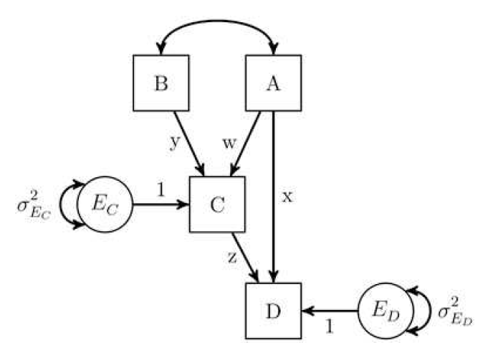
Lavaan syntax exercise
How do we write the model below in lavaan syntax?
How can we label and refer to the indirect effect from A on D via C in lavaan syntax?
What do the beta and psi matrices for this model look like?
Note that Beaujean often labels paths in lavaan syntax, but that is not required - I never do it, unless there are indirect effects that I want to explicitly define in the model. It does not make a difference for the estimated parameters and model fit.
Notes:
Beta: If A ~ B, A is on row and B is on column

Slide 47
Homework
Exercises 2.2 and 2.3 (see PDF on Brightspace)
See Example-2.4.1.pdf on Brightspace for instructions on extracting beta and psi matrices

